Slide 1
THE SHAPE OF A STIMULUS
Trajectory Geometry of Mouse V1 Population Activity
30563 MATHEMATICAL MODELLING FOR NEUROSCIENCE Project
Francesca Casillo, Alessandro Lombardi, Edoardo Panella, Federico Scaffidi Muta
Notes:
Talk about research question

Slide 2
A mouse watches three videos.
Do its neurons code them as three distinguishable population states?
Notes:
Talk about research question

Slide 3
Why this slice of MICrONS for this research question?
CLIP
MONET2
TRIPPY
Natural movie footage
Grey-scale textured noise
Synthetic wave patterns
FUNCTIONAL DATA · ~8,000 NEURONS RECORDED SIMULTANEOUSLY ·
· 4 CORTICAL AREAS · V1 · LM · RL · AL
Notes:
"MICrONS gives us two kinds of data — anatomical connectivity and functional recordings. We use only the functional side." (brief pause, gesture at slide) "Around eight thousand neurons recorded simultaneously across four visual cortical areas, while the mouse watches videos. That simultaneity is what makes a population-level geometric question possible at all." (point to each panel) "Three stimulus classes: natural movies — Clip; grey-scale textures — Monet2; synthetic wave patterns — Trippy. These three colors stay with us for the rest of the talk."
TO DO:
- Change pictures, I don't like them

Slide 4
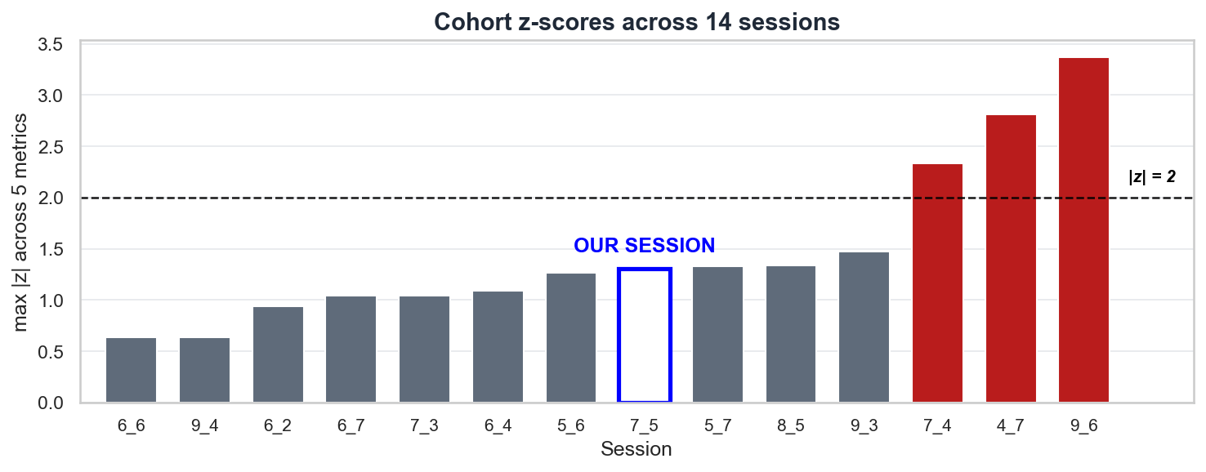
Session choice and trial structure
SESSION 7_5 · |z| ≤ 1.31 ACROSS ALL METRICS · 8,194 NEURONS (COHORT MEDIAN: 8,176) 453 TRIALS · 377 CLIP · 38 MONET2 · 38 TRIPPY · INTERLEAVED
Notes:
MICrONS has 14 recording sessions. We surveyed all of them — five summary metrics per session, z-scored across the cohort." (slide reveals) "Three sessions cross the |z| = 2 threshold: one with extreme response magnitudes, one with an unusually large field of view, one with frequent running." (point to highlighted bar) "Session 7_5 sits at the clean end — |z| under 1.31 on every metric, neuron count right at the cohort median. That's our deep-dive session." "Within it: 453 trials, 377 Clip, 38 Monet2, 38 Trippy — interleaved across the session, so slow drift can't masquerade as class identity.

Slide 5
Preprocessing techniques
Running influences V1 — 11 outlier trials removed (2.4%)
Photobleaching — linear detrend per trial
PIPELINE: OUTLIER FILTER → LINEAR DETREND → PER-NEURON Z-SCORE
Notes:
Two preprocessing decisions worth showing." (slide reveals)
"First — running. Mouse locomotion modulates V1 activity. We found a strong negative correlation — −0.39 — between treadmill speed and per-trial mean activity, driven by these eleven outlier trials with high running. Removing those eleven brings the correlation down to −0.22, safely below threshold. Class balance is preserved."
"Second — photobleaching. Calcium fluorescence decays about 45% across the session. Without correction, that drift would dominate any PCA. We fit a linear detrend per trial."
INSERT SOMEWHERE (don't know where yet): Variance scales with the mean here, so z-scoring is more appropriate than a square-root transform.

Slide 6
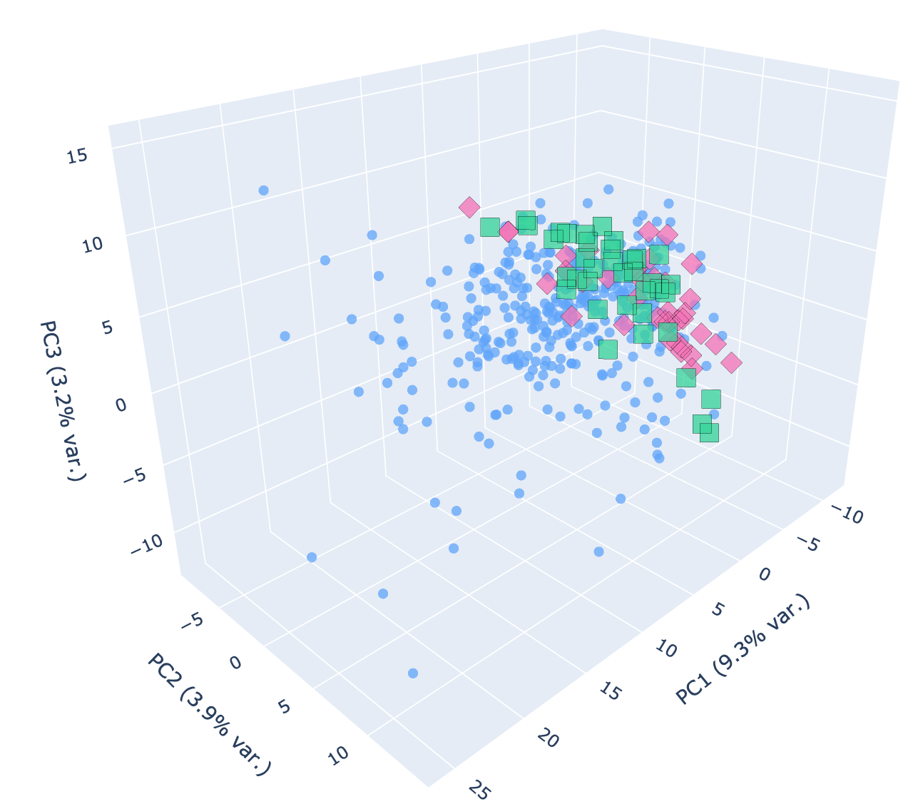
Experiment 1: trial-mean PCA
each trial → mean activity vector → PCA
BUT
98.9%
classifier accuracy on the same trial-mean vectors
majority baseline: 83.2%
LM 98.0% · RL 97.8% · AL 94.7%
n = 453 trials · 5,485 neurons · top 3 PCs
THE SIGNAL IS THERE. PCA ISN'T ALIGNED WITH IT.
Notes:
Our first experiment: collapse each trial to a single mean activity vector. One point per trial. Run PCA per cortical area. Look for clusters." (slide reveals)
(point to plot) "In V1, Clip separates cleanly. But Monet2 and Trippy collapse onto each other — to PCA they look like the same stimulus."
(point to 98.9%) "Here's the catch. A logistic regression classifier on the same trial-mean vectors hits 98.9% on V1 — and over 94% in every area, well above the 83% majority baseline. So the discriminative signal is in those vectors. PCA just isn't aligned with it. The high-variance directions PCA prioritizes — drift, arousal, global state — aren't the directions that separate the classes."
Two diagnoses motivate the next experiment: the directions PCA finds aren't the discriminative ones. And trial-averaging itself may be hiding Monet2 vs Trippy. Both point to keeping the time axis.
AGGIUSTARE PLOT e aggiungere link
OVERALL AGGIUSTARE DESIGN

Slide 7
Experiment 2:
Trial-averaged trajectories - projected into PC space
Three separated blobs in every area
BUT IS THE SEPARATION REAL?
Notes:
"Hypothesis from Experiment 1: trial-averaging may have hidden the Monet2-vs-Trippy distinction. So we kept the time axis."
(slide reveals)
"For each stimulus class, we average trials frame-by-frame to get a 75-frame trajectory. Then project all three trajectories into PC space, area by area." (let it land)
(point to grid)
"And we get this. Three cleanly separated regions in every cortical area — V1, LM, RL, AL. The blobs are stationary, not dynamic — each stimulus has a fixed address in state space, and frames cluster inside it. Looks like the time axis recovered the signal."
(beat, then transition)
"But before we celebrate — how confident can we be?"
FARE MEGLIO PLOT!!!! FA CACARE COSì

Slide 8
Biased: PCA fit on real-label trial averages, then shuffled data projected through the same PCs honest test: full feature space · no projection · all neurons
Monet2 ⇔ Trippy never reliably separates in any area
THE COLLAPSE PERSISTS
Notes:
"Before we celebrate the pretty picture from the last slide — there's a problem with that test." (beat)
"We fit PCA on the real-label trial averages. Then to compute the null distribution, we projected shuffled-label data through the same PCs. By construction, those PCs maximize between-class variance under real labels — so they amplify real distances relative to the shuffle null. The PC-space test was biased."
(slight pause, gesture at chart)
"So we redid the test honestly: full feature space, all neurons, no projection. These are the p-values across all four areas, for each pair." (point to chart)
"Three groups. The middle group, Clip vs Trippy — exactly one bar crosses the threshold: RL, p = 0.02. Everything else: not significant."
(point to right group)
"And critically — Monet2 vs Trippy. The two synthetic stimuli. Never crosses threshold. In any area."
"The collapse from Experiment 1 wasn't an artifact of trial-averaging. It's real."
AGGIUSTARE PLOT!!!

Slide 9
Two controls—both pass
V1's apparent lead vanishes after matching neuron count.
TRIAL-COUNT CONTROL
Clip subsampled to 38 trials
(matched to Monet2 / Trippy)
DISTANCES UNCHANGED
Robust to trial-count asymmetry
Linear methods hit a ceiling even with the time axis
Notes:
"Two controls before we move on." (brief pause)
(point left) "First, population size. Euclidean distance grows mechanically with neuron count, so V1's larger raw distances could just be a population effect. We subsampled every area to AL's 414 neurons. After matching — every area collapses to the same band. Per neuron, V1 has no information advantage."
(point right) "Second, trial count. Clip has 377 trials, the synthetics 38. We subsampled Clip to 38 to match — distances unchanged. The Clip-vs-synthetic distance isn't an artifact of trial-count asymmetry."
(beat, then drop the take-home tone)
"Both controls pass. The collapse is real. Linear methods hit a ceiling — even with the time axis."
(transition)
"So we asked one more question: does the method work within a class?"

Slide 10

Experiment 3: same method—zoomed inside Clip
Cinematic
sport1m
Three sub-categories separate in every area with p ≤ 0.02
BUT IS ONE AREA SPECIAL?
Rendered
Notes:
"After Experiment 2, we asked: linear methods can't crack synthetic-vs-synthetic. But maybe they find structure within a class — if the categories are content-distinct enough."
(point to stills)
"Within Clip, MICrONS labels three sub-categories. Cinematic — clips from real movies, Mad Max, Star Wars, The Matrix. sports1m — basketball, cycling, athletics. And Rendered — synthetic 3D-engine output. No real cameras."
(point to grid)
"Same trajectory method, same statistical test. In every cortical area, all three pairs separate at p ≤ 0.02. PCA does recover content-level structure when categories are content-distinct enough."
(beat, then transition tone)
"But there's a twist."

Slide 11
After population matching – per-neuron signal
AL is a naturalness detector, the same axis Experiment 2 found.
AL detects artificiality, not the category.
The same boundary, again.
Notes:
"Our second within-Clip finding. We matched every area to AL's 414 neurons — so we're now comparing per-neuron signal, not raw population size."
(point to first group)
"On Cinematic versus sports1m — naturalistic against naturalistic — every area performs the same. No per-neuron advantage anywhere."
(point to groups two and three)
"But on Cinematic versus Rendered, and sports1m versus Rendered — both involving the synthetic category — AL clearly stands out. Per-neuron, AL is the only area with an advantage."
(beat)
"AL isn't sensitive to content category in general. It's sensitive to the naturalness boundary."
(short pause, then transition tone)
"Which, looking back, is the same boundary linear methods kept finding throughout this project."

Slide 12
LIMITATIONS
WHAT COMES NEXT
Linear methods may miss non-linear structure
Single session (7_5) - cohort generalization untested
Connectomics unused – structural link untested
Alternative methods: CEBRA or MANIFOLD EMBEDDINGS
  designed for exactly this regime
Cross-session replication
Functional ↔ structural link
  use the connectome to test whether functional clusters reflect wiring
Linear methods sense the naturalness boundary
but hit a ceiling for synthetic vs. synthetic
Notes:
Talk about research question"Stepping back. The headline finding: linear methods sense the naturalness boundary. They reliably distinguish naturalistic content from synthetic stimuli — and area AL specifically excels at this distinction at the per-neuron level. But for separating two synthetic textures from each other — Monet2 from Trippy — linear methods hit a ceiling, even with the time axis."
(brief pause, then move to limitations)
"Three limitations worth flagging."
"First — and most importantly — the linear ceiling itself. Non-linear structure may exist in the data that PCA can't reach. Methods like CEBRA — a contrastive non-linear embedding — or manifold approaches like UMAP are built exactly for this regime. They'd be the natural next step."
(point briefly to second row)
"Second, this is one session. Cross-session validation is needed before generalizing the AL finding."
(third row)
"Third, our stimulus categories aren't matched on low-level image statistics — brightness, contrast, motion energy. Some of what we attribute to 'naturalness' could be those low-level features instead. Matched stimuli would be the cleanest control."

Slide 13
Any questions?
Notes:
Talk about research question

Slide 14
THANK YOU!

